Slide 1
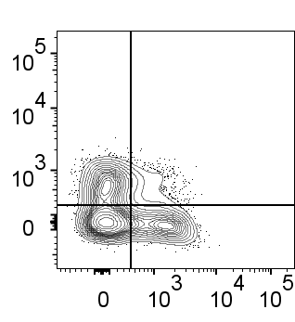
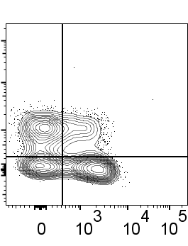
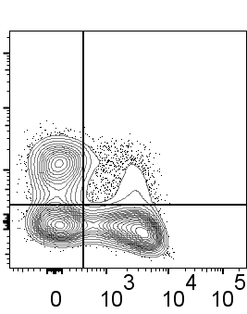
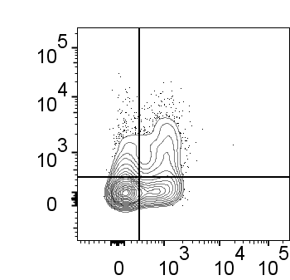
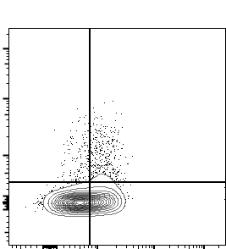
SUPPLEMENTARY FIG. 2
A
Whole Blood
AAb-
AAb+
T1D
26.3
10.19
26.6
15.1
24.4
9.10
CXCR3
32.5
30.9
21.5
36.7
32.4
34.0
B
CCR6
Tfh1 (%)
Tfh1/17 (%)
Tfh17 (%)
Tfh2 (%)
C
Whole Blood
AAb-
AAb+
T1D
10.2
17.0
15.1
7.88
3.01
6.82
PD-1
51.0
21.9
59.0
18.0
60.9
28.7
CXCR3
D
CXCR3-PD-1+ (%)
CXCR3+PD-1+ (%)
CXCR3+PD-1- (%)

