Slide 1
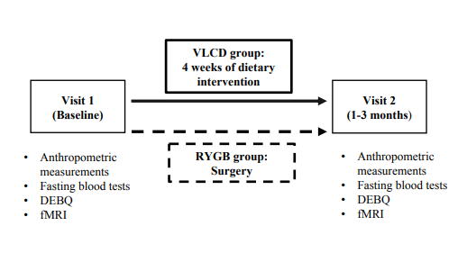
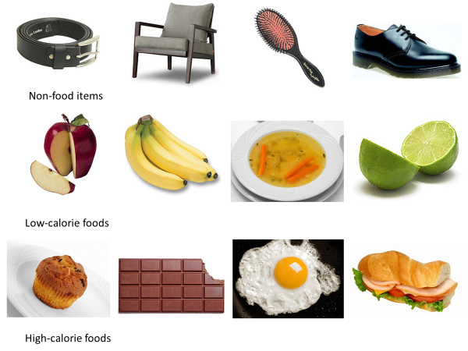
SUPPLEMENTARY FIGURES
SUPPLEMENTARY FIGURE 1A.
SUPPLEMENTARY FIGURE 1B.

Slide 2
SUPPLEMENTARY FIGURE 2A.
SUPPLEMENTARY FIGURE 2B and 2C.

Slide 3
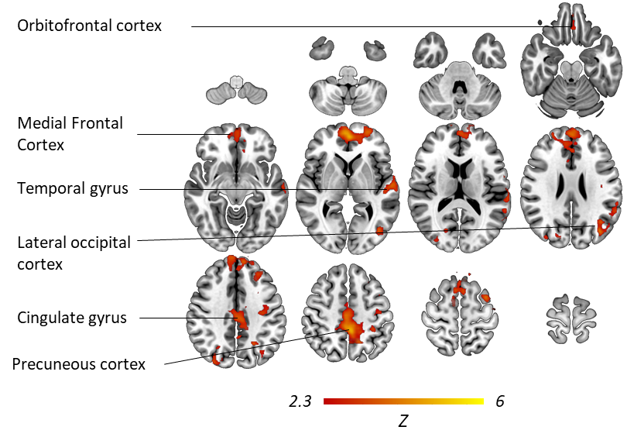
SUPPLEMENTARY FIGURE 2E.
SUPPLEMENTARY FIGURE 2F and G.

