Slide 1
Supplementary Table 1: Mutations in the participants with Alström syndrome (ALMS)
Type | Allele 1 | Homo/Hetero/Compound Het | Allele 2
ALMS | c.10769delC (p.Thr3590LysfsX6) | CH | c.5356A>G (p.Asn1786Asp)
ALMS | c.6895delG (p.val2299TrpsX43) | CH | c.11443C>T (p.Gln3815X)
ALMS | c.6584delA (p.Lys2195SerfX10) | CH | c.1008_1009delTG (p.Cys336fsX1)
ALMS | c.6823C>T (p.Arg2275X) | CH | c.9535C>T (p.Arg3179X)
ALMS | c.11101C>T (p.Arg3703X) | CH | c.6526 C>T(p.Gln2176X)
ALMS | c.10579_1580delAT (p.Met3527Valfs*13) | CH | c.11856delC (p.Asn3952Lysfs*41)
ALMS | c.4937C>A (p.Ser1646X) | Homo | c.4937C>A (p.Ser1646X)
ALMS | c.11101C>T (p.Arg3703X) | CH | c.6526 C>T(p.Gln2176X)
ALMS | c.10483C>T (p.Gln3495X) | CH | c.10775delC (p.Thr3592LysfsX6)
ALMS | c.4937C>A (p.Ser1646X) | Homo | c.4937C>A (p.Ser1646X)
ALMS | c.4937C>A (p.Ser2646X) | Homo | c.6526C>T (p.Gln2176X)
ALMS | 11107C>T (p.Arg3703X) | Homo | 11107C>T (p.Arg3703X)

Slide 2
A
B
Fig. S1

Slide 3
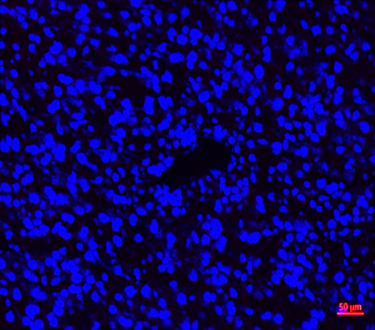
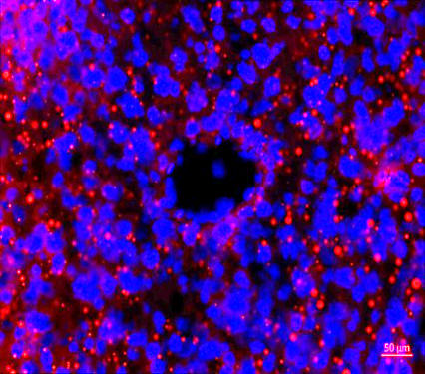
A
*
B
6-month old circulating free fatty acids levels
WT
FA
*
*
*
*
C
6-month old liver cryosections
WT
FA
Hepatic triglycerides, DAPI
Fig. S2

Slide 4
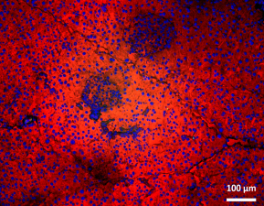
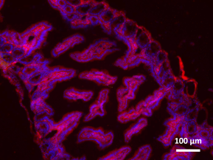
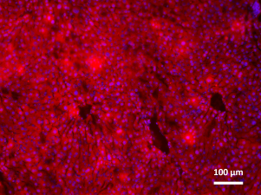
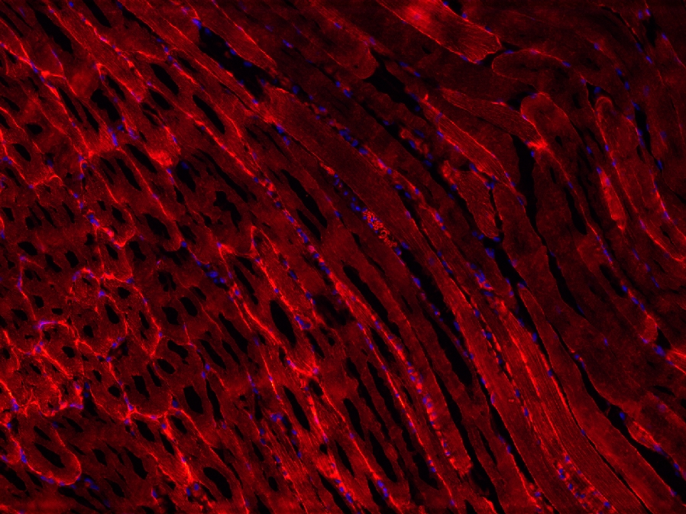
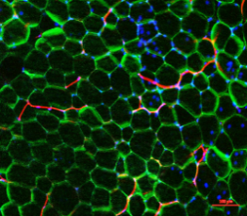
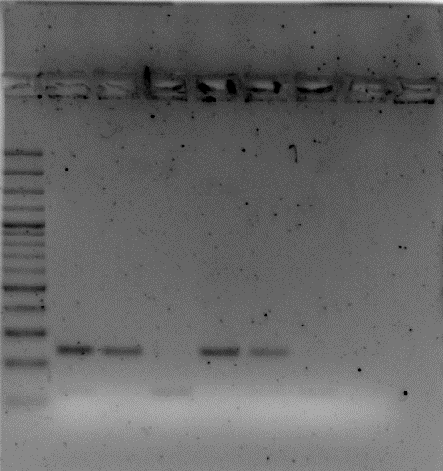
A
B
Alms1 allele with integrated targeting cassette (Alms ^{flin} allele)
Adiponectin-Cre^{+/-}; RosaTomatoeGFP^{+/-}
Pancreas
Gut
Liver
…
2
5
6
FRT
loxP
FRT
loxP
7
…
lacZ
neo
Alms1 allele following Cre-activity
Muscle
Adipose Tissue
2
5
6
…
FRT
loxP
7
…
lacZ
C
Alms1 ^{flin/flin} genotyping PCR
Forwardprimer common | TCA TCA GTG AAG AGC GGT TG
Reverse primer wt | GAA CTT CGG AAT AGG AAC TTC G
Reverse primer mutant | TTG GGA ATG GAG AGA TTT GC
1000
500
300
01
02
03
04
05
06
(-)
200
100
WT allele = 242 bp
Alms flin allele = 118 bp
Fig. S3

Slide 5
A
ALMS1
B
C
PREF-1
cEBPδ
N.F.E.
N.F.E.
N.F.E.
*
*
*
*
*
*
*
*
D
(days)
E
(days)
F
(days)
cEBPZ
cEBPβ
cEBPα
*
N.F.E.
N.F.E.
N.F.E.
(days)
(days)
(days)
G
H
PPARγ
N.F.E.
*
N.F.E.
(days)
Fig. S4

